Slide 1

The Princess Alexandra Hospital NHS Trust (PAHT)
INSERT LOGO HERE
Green Plan
2025 - 2028

Slide 2
Contents
3 Foreword
4 Introduction
5 NHS Core Carbon Footprint and Footprint Plus
6 Our New Green Plan
7 System Leadership and Workforce
8 Net Zero Clinical Transformation
9 Digital Transformation
10 Medicines
11 Travel and Transport
12 Estates and Facilities
13 Supply Chain and Procurement
14 Food and Nutrition
15 Adaptation
16 Governance
17 Green Plan Action Tracker

Slide 3
Foreword
At The Princess Alexandra Hospital NHS Trust, we are proud to present our latest Green Plan, an integral part of our organisational strategy and our commitment to creating healthy places and healthy communities. We recognise that environmental sustainability is not just about compliance; it is about shaping a future where the health of our population and the health of our environment go hand in hand.
Our Green Plan is aligned to the NHS 10 Year Plan by embedding sustainability into our organisational strategy and supporting its vision for prevention, integration, and healthier communities.
We are actively transforming our estate to support integrated care models that enable virtual consultations, remote monitoring, and ambulatory services within community hubs. This strategic shift aligns with our PLACE ambitions and the wider ICS strategy to deliver care closer to home and support the preventive health agenda, while easing pressure on our acute hospital site’s ageing infrastructure. Shifting appropriate clinical activity from our acute site into community locations, virtual pathways and hospital at home models will significantly reduce our environmental footprint. National evidence shows that community delivered and virtual care pathways materially cut carbon emissions by reducing avoidable patient travel, lowering energy intensive inpatient bed days, and enabling digital-first clinical models. This approach supports the NHS Net Zero ambition while improving access, equity and prevention across West Essex.
Our Green Plan sets out a bold roadmap to 2028, with over 40 targeted actions spanning clinical transformation, procurement, digital innovation, and workforce engagement. These actions are grounded in operational reality and supported by a robust tracking system that ensures transparency and accountability.
We are particularly proud of our waste management performance, which has been recognised as exemplary. Our teams have consistently achieved high segregation rates, reduced clinical waste volumes, and embedded circular economy principles. Building on this success, we are now exploring innovations in waste, water, and electrical systems—including smart metering, low-carbon technologies, solar and digital asset management—to further enhance sustainability and resilience.
The Annual Sustainability Report complements the Green Plan by showcasing our achievements to date, including:
LED installations across the estate
Heat decarbonisation planning
Removal of desflurane from anaesthetic practice
Creation of green spaces for staff and patients
It also confirms our compliance with national reporting standards, including the Group Accounting Manual and the Task Force on Climate-related Financial Disclosures (TCFD). With NHS England now centrally calculating carbon footprints for all Trusts, we are focused on delivering tangible local impact.
Looking ahead, we are establishing a Sustainability Steering Group to drive delivery and foster cross-divisional ownership of our green commitments. This group will ensure our sustainability actions are embedded across clinical, operational, and corporate domains.
Sustainability is now part of how we deliver and support the wellbeing of our communities. I invite all colleagues, partners, and stakeholders to join us in this mission.
Together, we will create a healthier, greener, and more resilient future for our patients, our staff, and our communities.
Thom Lafferty
Chief Executive
The Princess Alexandra Hospital NHS Trust

Slide 4
Introduction
At The Princess Alexandra Hospital NHS Trust, we recognise that environmental sustainability is fundamental to our organisational strategy and our mission to deliver outstanding care. Our Green Plan is not just a compliance document—it is a blueprint for creating healthy places and healthy communities, where the environment and population health are inseparable.
By embedding environmental considerations into every aspect of our planning and operations, we are supporting the NHS’s Net Zero ambitions and the Health and Care Act 2022, requirements. More importantly, we are investing in the long-term wellbeing of our patients, staff, and local population. Greener buildings, sustainable travel, responsible resource use, and enhanced green spaces all contribute to healthier environments and, in turn, healthier lives.
Our approach aligns with the NHS Long Term Plan, which sets out a bold vision for transforming health and care over the next decade. This national strategy emphasises three fundamental shifts: moving care from hospitals into community settings, enabling a fully digital NHS, and prioritising prevention over treatment. By embedding sustainability into our organisational strategy, we actively support these ambitions. Creating healthy places and healthy communities is central to our work, through neighbourhood health centres and services located on the high street or within shopping centres, making healthcare more accessible and tackling health inequalities. These initiatives not only improve wellbeing but also revitalise local communities and reduce pressure on acute hospitals. We are harnessing the power of technology to enhance patient experience, diagnosis, treatment planning, and NHS productivity, ensuring care is delivered efficiently and effectively. Our Green Plan underpins these goals by reducing environmental impact and promoting a prevention-focused health system that delivers long-term benefits for patients, staff, and the wider population.
This approach plays directly into the preventative agenda: by reducing pollution, improving air and water quality, and fostering biodiversity, we help prevent illness and promote wellbeing across Essex and beyond. Our Green Plan is a key enabler of our vision for a resilient, sustainable, and prevention-focused health system—one that delivers tangible benefits for current and future generations.
Delivering more care within neighbourhood health centres, high street settings and digitally at home not only improves accessibility but also provides environmental benefit through reduced travel, reduced reliance on energy intensive hospital spaces, and support for the NHS’s prevention led sustainability approach.
Our last Green Plan
Since our last plan, we have successfully completed 18 high level workstreams and associated sub-actions, with a further 19 currently in progress - including ongoing improvement initiatives that are continuous by nature. The remaining workstream is to develop a biodiversity action plan. We are already incorporating biodiversity into our activities, with more than 150 new trees and shrubs planted during the last Green Plan, as well as opening our new reflection garden.

Slide 5
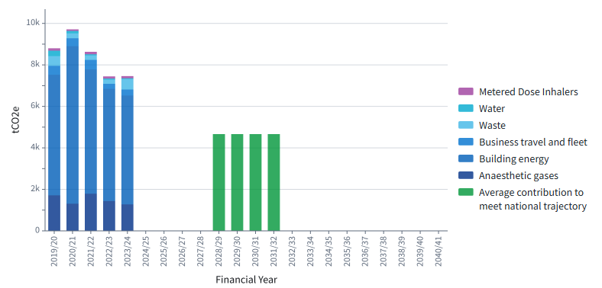
NHS Core Carbon Footprint and Footprint Plus
What is the Trust’s current Carbon Footprint?
The national NHS targets are defined against 1990 levels to allow comparison with the UK Climate Change Act (2008):
Reach net zero by 2040 for the emissions we control directly (the NHS Carbon Footprint), with an 80% reduction by 2028-2032 against 1990 levels;
Reach net zero by 2045 for the emissions we can influence but don’t directly control (the NHS Carbon Footprint Plus), with an 80% reduction by 2036-2039 against 1990 levels
Those national targets – defined against the 2019/20 emissions footprint calculated in line with the Delivering a Net Zero NHS report – are equivalent to:
Reach net zero NHS Carbon Footprint by 2040, reducing emissions by at least 47% by 2028-2032;
Reach net zero NHS Carbon Footprint Plus by 2045, reducing emissions by at least 73% by 2036-2038.
The graph below illustrates our current carbon footprint trajectory, with emissions for 2023/24 at 7,459tCO₂e and a 2032 target of 4,663tCO₂e.
Our Carbon Footprint Plus baseline is 43,400 tCO₂e, with 28,518 tCO₂e attributed to our supply chain. We expect this to decrease as our suppliers progress on their journeys toward Net Zero. To support this, our procurement team has implemented a sustainable procurement policy aimed at meeting the reduction targets outlined above. Further details are provided in the Procurement section of this plan.
2025-2032 Trajectory

Slide 6
Our New Green Plan
This Green Plan for 2025-2028 has 10 specific areas of focus;
Workforce and Leadership
Net Zero Clinical Transformation
Digital Transformation
Medicines
Travel and Transport
Estates and Facilities
Supply Chain and Procurement
Food and Nutrition
Adaptation
Green Plan Governance
We have incorporated both ongoing actions and new initiatives informed by team input, updated guidance, and our continued commitment to achieving Net Zero across the NHS.
A complete list of these actions can be found at the end of this plan.
Whilst we expect to have a new hospital between 2035-2040, which would be run on electricity and not fossil fuels, the new hospital programme can be changed by future governments.
Therefore, we will need to make our current site “decarbonisation-ready”, in case we need to decarbonise between 2032 and 2040. This will include all the qualitative changes in this plan, plus:
Assessing our site for energy intensive equipment that needs to be upgraded.
Assessing equipment that uses energy from a fossil fuel source, such as heating and hot water.
Understand our building fabric, for upgrades needed and deciding when best to undertake the works.
Designing the concept for decarbonisation, including the use of future technology.
Whilst many of these actions can be done in later phases of the Green Plan, we can begin the assessments over the next 3 years.

Slide 7
Workforce and Leadership
Since our last Green Plan, we have seen a change in our timeline for our new hospital.
Because of this, many of the actions required for us to become a sustainable Trust need to be undertaken at our current premises.
However, through our management teams, we now have a much wider visibility of these actions and have already taken steps toward this goal.
We regularly report our progress to the board, as well as having a greater understanding of our estate and the carbon emissions we emit. Our procurement teams have worked to align with the national targets, and we now have external support for scoping and implementing carbon reduction projects.
Actions
Review the Trust’s working policies to identify where reductions in travel to work can be implemented
Identify suitable training opportunities for our staff on sustainability, including using NHS resources.
Encourage key members to undertake specialist sustainability training to ensure deliverability of the Green Plan
Assign each area of the Green Plan to the relevant stakeholders.
Create a Net Zero Trajectory plan, including funding routes available and interim targets for 2028.
Identify sustainability leads for each department to ensure that good practice is shared with all.
Engage with patients and visitors on issues of sustainable development policy.
Refresh our communications plan around the promotion of sustainable development to staff and visitors
Seek ideas from the wider public on how to improve our environmental and sustainability performance.
Support the running of food banks
Identify funding opportunities to support the transition to a sustainable Trust

Slide 8
Net Zero Clinical Transformation
Transitioning clinically appropriate services from hospital to community or home settings offers measurable carbon savings. UK studies show that virtual ward care emits approximately four times less carbon per bed day than traditional inpatient care (8.8 kg CO₂e vs 37.9 kg CO₂e), avoiding hundreds of tonnes of emissions annually. Embedding virtual wards, remote monitoring and ambulatory community models into our clinical transformation programme therefore delivers both environmental and patient flow benefits
Our clinical and non-clinical teams are aware of how important a role they play in our Trust becoming sustainable.
Over the last 3 years, we have worked to identify KPIs and targets for reducing our carbon emissions from the care we provide and have undertaken quality and service improvement projects.
In this green plan, we will continue this, with greater emphasis on quantifying the improvements, as well as ensuring that our projects have co-benefits such as improved waiting times, better patient flow, and increased efficiency of our processes.
Actions
Establish a clinical lead and multidisciplinary working group responsible for reducing emissions in the clinical areas
Complete quality improvement projects that have a measurable reductions in emissions - whether it be related to medicines, waste, energy use, or other areas.
Identify co-benefits of projects for quality of care, efficiency and reducing healthcare inequalities
Share our good practices with our clinical groups, the wider Trust, and NHS England.

Slide 9
Digital Transformation
At our Trust, we have adopted pay-as-you mail and app-based messaging since our last plan.
Alongside this, a paper reduction campaign to reduce our printer use has reduced our paper usage on site, and we will soon have access to measurable data to monitor this in future. We have also switched to recycled paper for all our printing.
Where patients agree, we now use electronic letters using systems we have in place, including letters to GPs.
Our blood test and X-ray requests from GPs are now all requested electronically, and any appointments for blood tests can now be booked via our website.
Digital-first models — including virtual consultations, electronic letters and remote monitoring — provide major sustainability benefits. Greener NHS analysis indicates that virtual outpatient appointments could avoid more than 200 million patient road miles and save over 400 kilotonnes of CO₂e annually across the NHS. Within PAHT, expanding digital communication and follow-up pathways will directly reduce travel emissions, paper consumption and building utilisation.
Actions
Develop our next Paper Reduction Awareness Campaign
Measure our paper usage and identify KPIs for further reduction
Review IT management processes and goods for low carbon alternatives

Slide 10
Medicines
Since our last plan, we have worked to understand and reduce our anaesthetic gases usage, including eliminating the use of desflurane, which has the highest carbon footprint of any gas we use in patient care.
NHS England now share our medical gases usage and carbon emissions, so we can target areas for improvement.
Over the next three years, we will continue to reduce our Nitrous oxide and Entonox waste and will produce our plan for their transition from piped to bottle systems.
Actions
Roll out Electronic Prescription Service (EPS)
Review of clinical stock levels
Review and reimplement the Trust’s Gloves Off campaign
Develop our plan for reducing Nitrous Oxide and Entonox usage
Review plans for reducing Metered Dose Inhalers (MDI) and anaesthetic gases

Slide 11
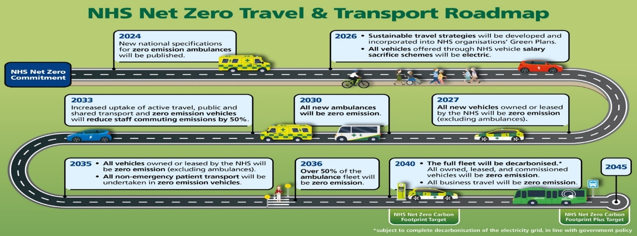
Travel and Transport
We already have a bike park on site, with showers and lockers for staff to use when they commute to work sustainably.
By relocating suitable clinical activity into community hubs such as St Margaret’s Hospital and the Harvey Centre, PAHT reduces patient and visitor travel to the acute site — a major contributor to the NHS’s travel related emissions. As travel and transport contribute around 14% of total NHS carbon output, shifting activity closer to where people live will be essential to achieving our Net Zero Travel & Transport commitments.
We have adjusted our salary sacrifice scheme to allow the purchase of EV vehicles only and have assessed our vehicle fleet to move to hybrid and ZEV.
Over the next 3 years, we will align to the NHS Net Zero Travel and Transport Roadmap.
Actions
A review of our changing facilities to ensure they are suitable for our staff to commute by bicycle, running or walking.
A review of current bike storage and improvements that can be made.
Continue to identify areas for EV charging for staff and visitors.
Develop our Sustainable Travel Plan.

Slide 12
Estates and Facilities
Our new hospital will comply with the NHS Net Zero Carbon Hospital Standard.
However, whilst we expect to be moving into our new hospital by 2040, our current premises need to be a sustainable base for the next 15 years.
Supporting this decarbonisation journey, moving clinical activity from high energy acute environments into lower carbon community estate reduces demand on the most carbon intensive parts of our infrastructure. Community sites typically have shorter occupancy durations, lower energy intensity, and allow for modernised, efficient service layouts aligned with Net Zero Estates Technical Annex requirements.
Since our last Green Plan, we have made significant steps to reduce our building energy, through behaviour change and capital projects.
We have secured over £3 million in central government funding in the last 3 years to upgrade LED lighting to 100% coverage, as well as add controls to our cooling systems to increase efficiency.
In addition, we have engaged a specialist consultancy team to act as our energy managers. They provide monthly reporting on our building performance, identify areas for improvement, and assist in developing business cases for capital and revenue projects.
Actions
Review how we use the space in our buildings.
Work to understand the minimum energy requirements for electricity, heating and cooling of our hospital.
Review our Heat Decarbonisation Plan (HDP) for solutions we can implement for the medium term.
Review our site for mechanical and electrical engineering efficiency improvements.
Continue to apply for External and Internal funding for building improvements
Identify and implement Solar PV on our sites
Align to the Net Zero Estates Technical Annex Guidance

Slide 13
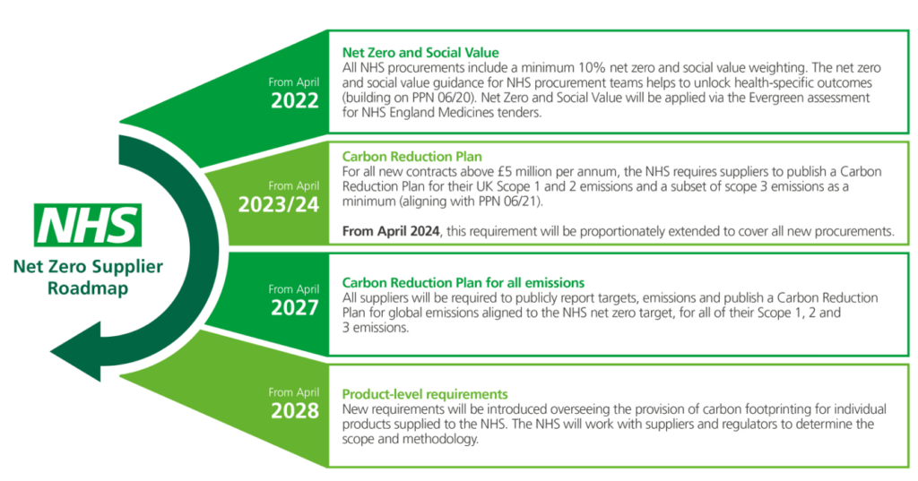
Procurement
Emissions from procurement make up a large part of our NHS Carbon Footprint Plus and need to be reduced by 73% by 2038 to align with national targets.
To address this, we are working through the NHS Net Zero Supplier Roadmap to reduce emissions associated with the goods and services we purchase.
We have adopted the first two Procurement Policy Notes (PPNs), focusing on Social Value and Carbon Reduction Planning.
From April 2024, all prospective suppliers have been required to submit a Carbon Reduction Plan alongside their bids. From 2027, this requirement will extend to all existing suppliers, who must also publicly report their carbon reduction targets.
By April 2028, all products listed on the SBS catalogue will include a declared carbon footprint. While this will enhance reporting and transparency, we will also continue to explore more sustainable alternatives to commonly used items, such as single-use products and reusable PPE.
Actions
Review our largest suppliers to understand their carbon emissions due to our activities
Identify our largest contributors to our carbon emissions, including goods and delivery options, and encourage them to share data to show their improvements.
Capture and quantify the sustainability improvements directly attributable to procurement

Slide 14
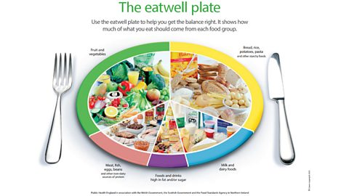
Food and Nutrition
Since our last plan, we have implemented several schemes to reduce the waste, and types of waste, that come from our catering on site.
Our single use plastics have been replaced with wooden, recyclable utensils, and our takeaway containers have been changed from polystyrene to cardboard.
This has resulted in an increase in recyclable waste compared to landfill.
Our menus have also changed since our last plan, with more healthy options available, and in the next 3 years we will continue to improve this.
The sustainable changes we make in this area will be seen not just during this plan but will inform the services we provide at our new site in 2040.
Actions
Have a weekly vegetarian day on the inpatient menus – where no meat options available – in line with dieticians’ advice.
Ensure that all contractors have their own carbon reduction plans when tendering their services for catering and waste.
Review current food waste percentages with a goal of remaining below the guidance levels

Slide 15
Adaptation
Since our last plan, we have aligned to the NHS’s TCFD guidance, reporting through our annual report on sustainability risks, governance, metrics and targets, as well as reviewing our processes for developing these.
Whilst we have many risk assessments on our register that link to climate change, through this plan, we will link them formally into a Climate Change risk assessment and add it to our register.
Over the next three years, the TCFD guidance for the NHS is becoming more comprehensive, so by working with our partners, we will continue to inform staff, patients and visitors of our plans and achievements in becoming a sustainable Trust as the climate changes.
Actions
Implement a Climate Change Risk Assessment
Align to TCFD reporting guidance from the NHS (DHSC GAM)
Identify the risks to service provision specifically from climate related events, and incorporate these within our risk register

Slide 16
Governance
We have established a Sustainable Steering Group (SSG) to drive sustainability across the Trust, support project delivery, and gather evidence to inform business cases.
The Sustainability Steering Group will also monitor the environmental impact of pathway redesign, including carbon savings from virtual wards, virtual outpatient appointments, and service relocation to community hubs. This will ensure that clinical service transformation is fully integrated with our Net Zero trajectory.
This structure will enable us to identify, deliver and measure sustainability activities across the Trust, with key department heads invited.
The group will also include a lead for each section of the Green Plan, for effective communication on progress and issues.
We will review our Green Plan actions quarterly, and our overall plan annually to ensure that objectives remain on track and are being met.
Our Net Zero Lead will provide regular updates to the Board, and key progress highlights will be included in the Trust’s annual report.
We will also link the group to the current Performance and Finance Committee, and the Business Steering Group, to ensure that sustainability aims are considered in other areas of the Trust’s operations.
Actions
Receive feedback from the chapter leads at each SSG meeting to ensure we are on track
Review plans with the board annually for new actions and targets
Identify KPIs for all areas, including NHS metrics and carbon emissions, that can be reported at least quarterly

Slide 17
Green Plan Action Tracker
Reference | Action | Goal | Date for Progress | Lead

